Slide 1
Web-Service and Cloud Computing

Slide 2
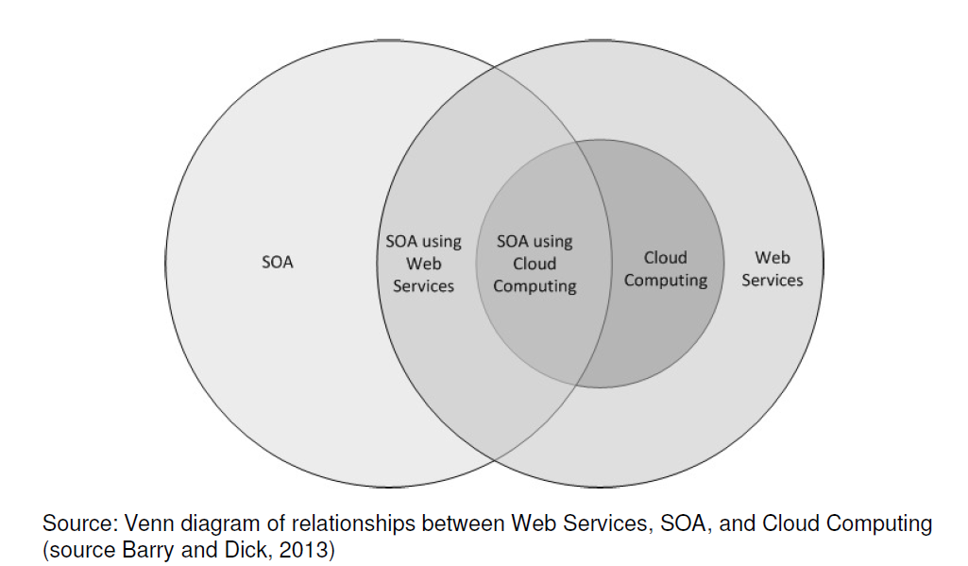
Web-Service and Cloud Computing

Slide 3
Web-Service and Cloud Computing
• Cloud Computing and SOA are independent approaches.
• Cloud Computing is a broad term for any Web service, which offers the entire “traditional IT stack”, such as software, hardware, and applications.
• SOA, instead, focuses mainly on software services
• Web Services encapsulates Cloud Computing in this diagram because Cloud Computing uses Web Services for connections.

Slide 4
Web-Service and Cloud Computing
It is possible, however, to use Web Services in situations other than Cloud Computing. Such use of Web Services may be part of a service-oriented architecture.
It is possible to have a service-oriented architecture and not use Web Services for connections.

Slide 5
Remote Procedure Call (RPC)
• An extension of conventional procedure call (used for transfer of control and data within a single process)
• allows a client application to call procedures in a different address space in the same or remote machine
• ideal for the client-server modeled applications
• primary goal is to make distributed programming easy, which is achieved by making the semantics of RPC as close as possible to conventional local procedure call

Slide 6
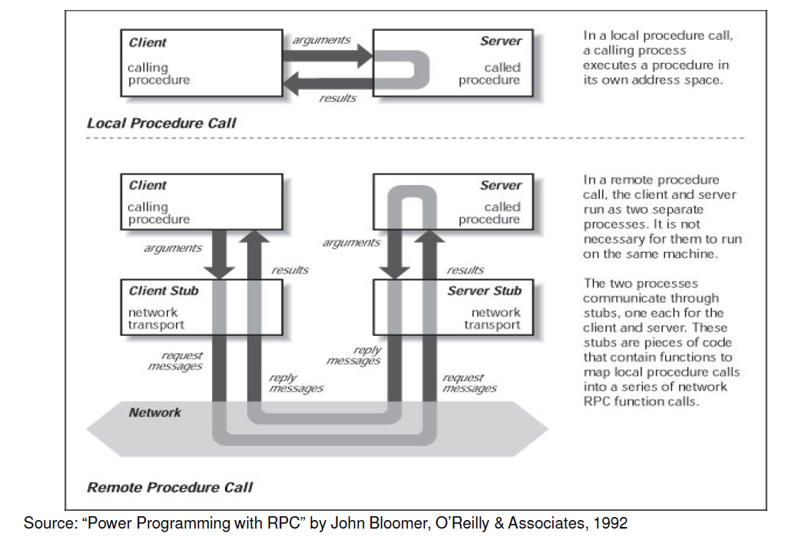
Local vs. Remote Procedure Calls

Slide 7
Steps of a Remote Procedure Call
1. Client calls stub
client functions
server functions
client stub
server stub (skeleton)
network routines
network routines
client
server

Slide 8
Stub functions
2. Stub marshals params to net message
client functions
server functions
client stub
server stub (skeleton)
network routines
network routines
client
server

Slide 9
Stub functions
3. Network message sent to server
client functions
server functions
client stub
server stub (skeleton)
network routines
network routines
client
server

Slide 10
Stub functions
4. Receive message: send to stub
client functions
server functions
client stub
server stub (skeleton)
network routines
network routines
client
server

Slide 11
Stub functions
5. Unmarshal parameters, call server function
client functions
server functions
client stub
server stub (skeleton)
network routines
network routines
client
server

Slide 12
Stub functions
6. Return from server function
client functions
server functions
client stub
server stub (skeleton)
network routines
network routines
client
server

Slide 13
Stub functions
7. Marshal return value and send message
client functions
server functions
client stub
server stub (skeleton)
network routines
network routines
client
server

Slide 14
Stub functions
8. Transfer message over network
client functions
server functions
client stub
server stub (skeleton)
network routines
network routines
client
server

Slide 15
Stub functions
9. Receive message: direct to stub
client functions
server functions
client stub
server stub (skeleton)
network routines
network routines
client
server

Slide 16
Stub functions
10. Unmarshal return, return to client code
client functions
server functions
client stub
server stub (skeleton)
network routines
network routines
client
server

Slide 17
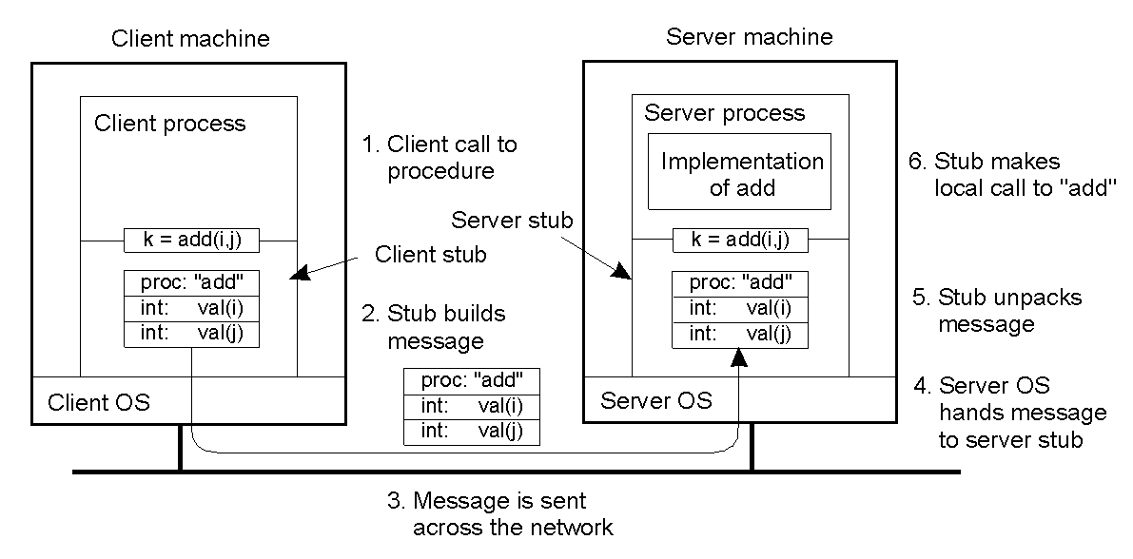
RPC Steps
Steps involved in doing remote computation through RPC

Slide 18
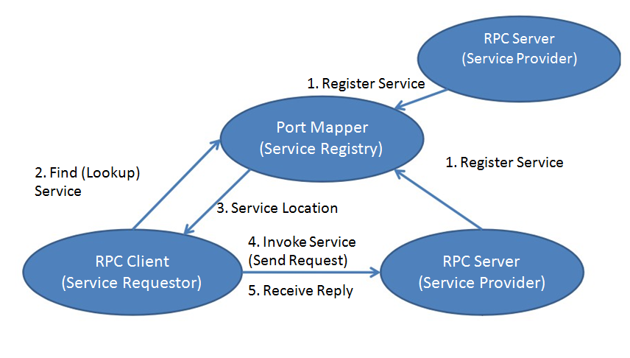
RPC Steps

Slide 19
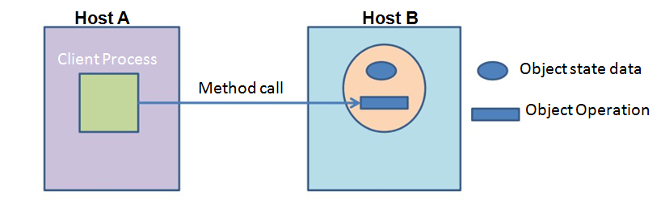
Distributed Objects
A process running in host A makes a method call to a distributed object residing on host B, passing with the call data for the parameters, if any.
A process which makes use of a distributed object is said to be a client process of that object, and the methods of the object are called remote methods.
Distributed Object Mechanism
• Java Remote Method Invocation (RMI),
• Common Object Request Broker Architecture (CORBA) systems,
• Distributed Component Object Model (DCOM)

Slide 20
CORBA v/s RMI
CORBA (Common Object Request Broker Architecture) has long been king
CORBA supports object transmission between virtually any languages
Objects have to be described in IDL (Interface Definition Language), which looks a lot like C++ data definitions
CORBA is complex
Microsoft supported CORBA, then COM, now .NET
RMI is purely Java-specific
Java to Java communications only
As a result, RMI is much simpler than CORBA

Slide 21
The General RMI Architecture
The server must first bind its name to the registry
The client lookup the server name in the registry to establish remote references.
The Stub serializing the parameters to skeleton, the skeleton invoking the remote method and serializing the result back to the stub.

Slide 22
The Stub and Skeleton
A client invokes a remote method, the call is first forwarded to stub.
The stub is responsible for sending the remote call over to the server-side skeleton
The stub opening a socket to the remote server, marshaling the object parameters and forwarding the data stream to the skeleton.
A skeleton contains a method that receives the remote calls, unmarshals the parameters, and invokes the actual remote object implementation.

Slide 23
Steps for Developing an RMI System
1. Define the remote interface
2. Develop the remote object by implementing the remote interface.
3. Develop the client program.
4. Compile the Java source files.
5. Generate the client stubs and server skeletons.
6. Start the RMI registry.
7. Start the remote server objects.
8. Run the client

Slide 24
Web Service
A web service is a self-contained, language neutral, platform independent, and loosely coupled application. It can be described, published, located, and invoked over the Internet
“Web services” is an effort to build a distributed computing platform for the Web.
Difference between Web-site and Web-Service
Web-site is made for human consumption
Web-service is for machine (application) consumption
Web Service Types
SOAP based( Simple Object Access Protocol )
REST based (Representational State Transfer)
Notes:
SOAP is a protocol.
REST is an architectural style.
SOAP defines a standard communication protocol (set of rules) specification for XML-based message exchange.
While REST stands for Representational State Transfer, which is an architectural style for networked hypermedia applications, it is primarily used to build Web services that are lightweight, maintainable, and scalable. A service based on RESTis called a RESTful service.

Slide 25
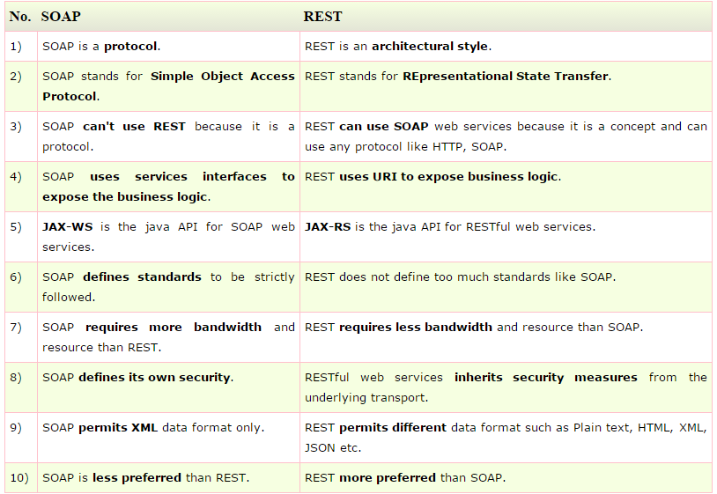
SOAP vs REST Web Services
Notes:
JAX-WS (Java API for XML Web Services)
JAX-RS: Java API for RESTful Web Services
JSON (JavaScript Object Notation)
Use SOAP when:
All you need is simple operations, like read only methods
Implementing a one-way or one-object service for something like data exchange or transfer
You want finer control over the specific transport of data, or can’t always use HTTP
Rigid specifications need to be enforced on incoming requests, and you want to minimize additional documentation needed for use
You can rely on client ability to parse XML, or more preferably SOAP itself
You need built-in error handling when things go wrong with requests
Use REST when:
Operations are complex, like create/read/update/delete on objects
Implementing a multi-faceted service for a variety of different objects
You want to easily and quickly target a variety of consumer end user devices as clients
Requests are generally stateless, like call and response compared to a conversation
Your clients may have limited bandwidth or processing power
You can leave it up to the client to get their requests correct and to deal with problems

